Slide 1
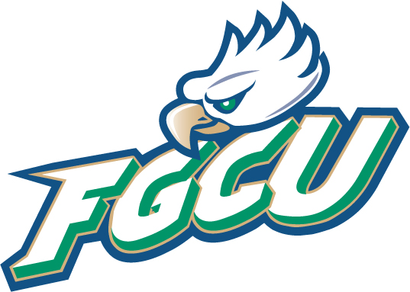
University Colloquium

Slide 2
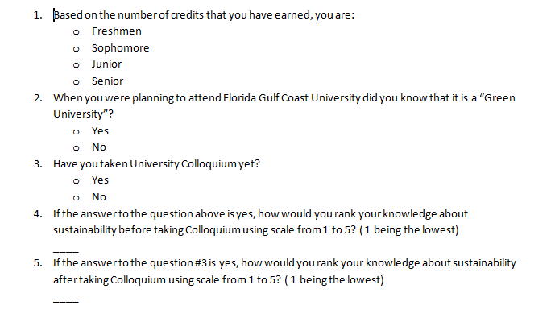
Survey

Slide 3
Colloquium- What is it?
It is a required course for all FGCU students.
It teaches you about environment and importance of sustainability.
When Colloquium was designed, the founding dean of the college of arts and sciences found inspiration in David W. Orr’s Earth in Mind: On Education, Environment, and the Human Prospect. Orr’s approach to environmental sustainability became a foundation of the new course.

Slide 4
According to FGCU website:
The University Colloquium is an interdisciplinary course designed to explore the concept of sustainability as it relates to a variety of considerations and forces in Southwest Florida. In particular, we consider environmental, social, ethical, historical, scientific, economic, and political influences.

Slide 5
The goals for students are to:
Provide a sense of place and an understanding of the unique ecological features of the Southwest Florida environment.
Assist in achieving the Florida Gulf Coast University learning goals of developing “an ecological perspective” and a commitment to “community awareness and involvement” and in teaching the related outcomes that state that the student will “know the issues related to economic, social, and ecological sustainability; analyze and evaluate ecological issues locally and globally; and participate in collaborative projects requiring awareness and/or analysis of ecological and environmental issues.”
Enable a working understanding of sustainability, of environmental education, and of ecological literacy.

Slide 6
Service Learning
One of the requirements of this class is to complete 10 hours of service learning that would be connected to environment.
There is many opportunities on campus to complete these hours. For example: Campus trail clean up, Earth Day, Vampire Walk, Recyclomania, Happehatchee, FGCU Freshman Orientation Game production and many more.(depends which semester you choose)

Slide 7
You get to go on field trips!
As part of the course you will go on several fieldtrips. Including tour around FGCU campus and trails, and trips to Waste to Energy Plant and Recycling Facility, Matanzas Pass Preserve in Fort Myers Beach as well as Corkscrew Swamp Sanctuary.

Slide 8
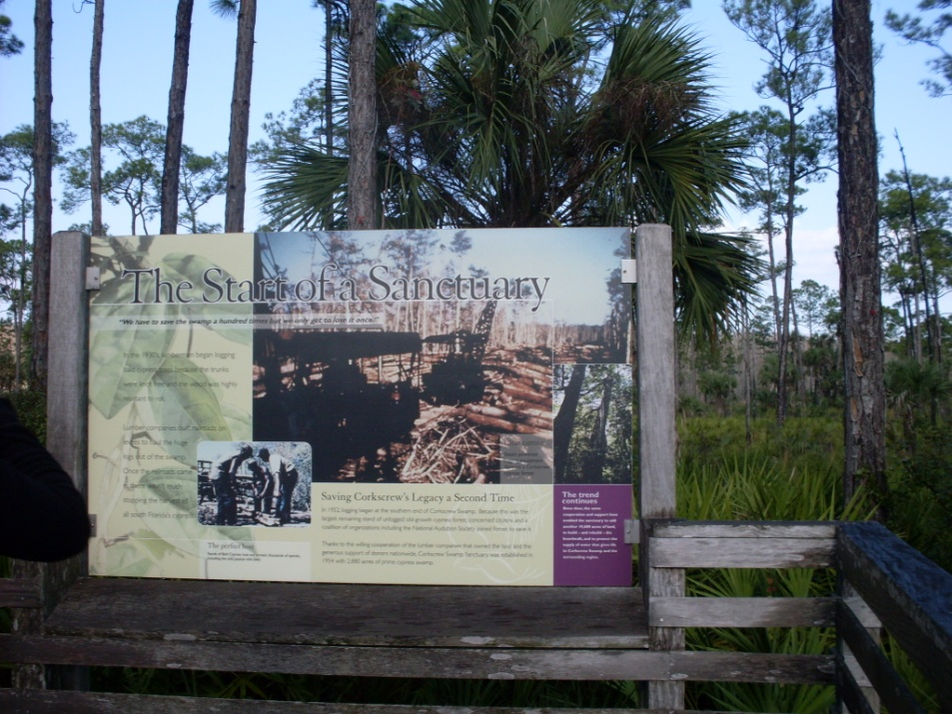
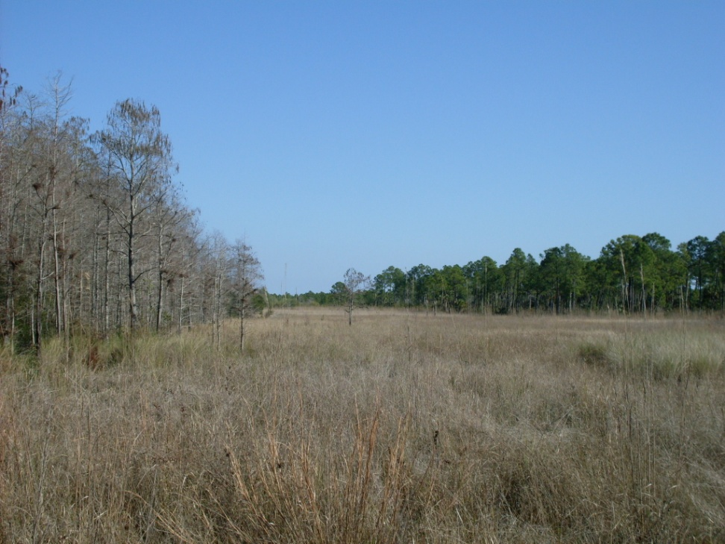
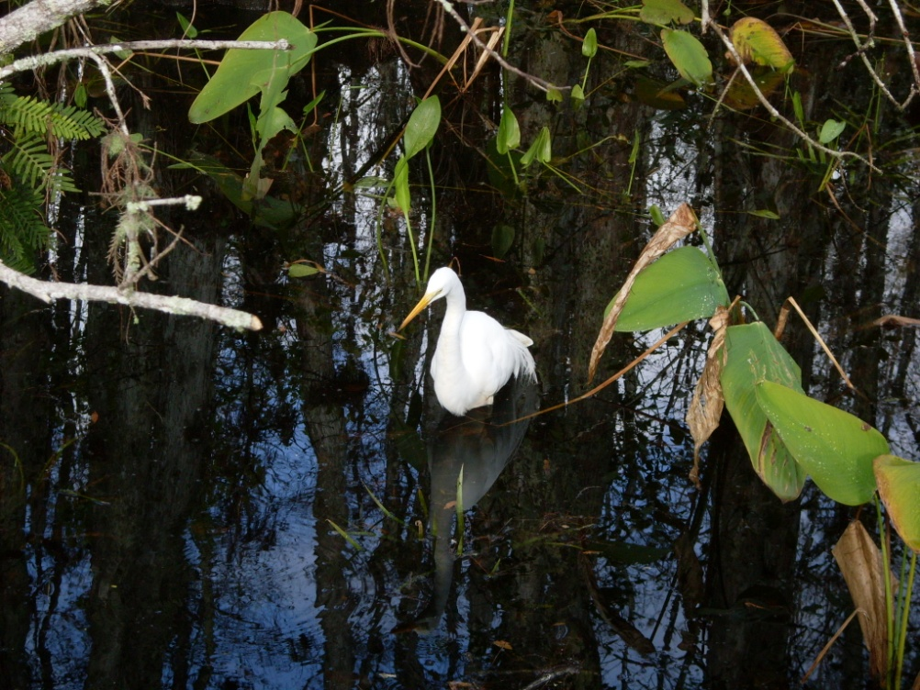
Corkscrew Swamp Sanctuary

Slide 9
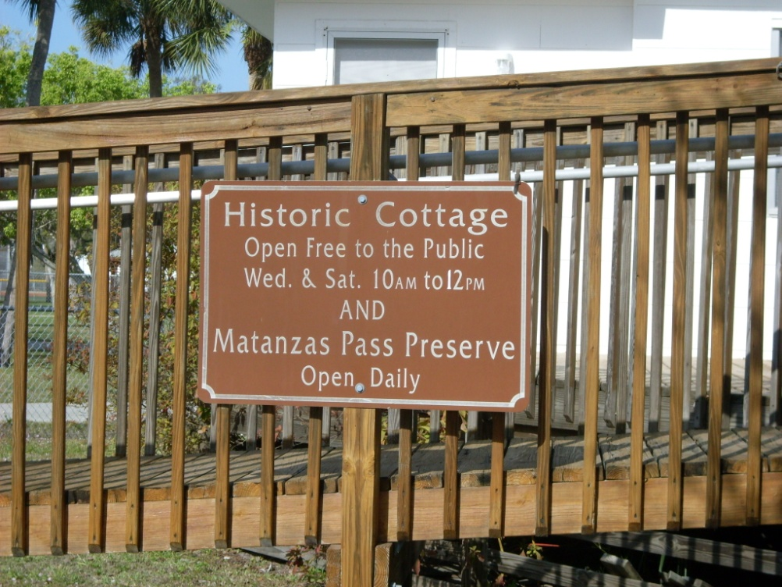
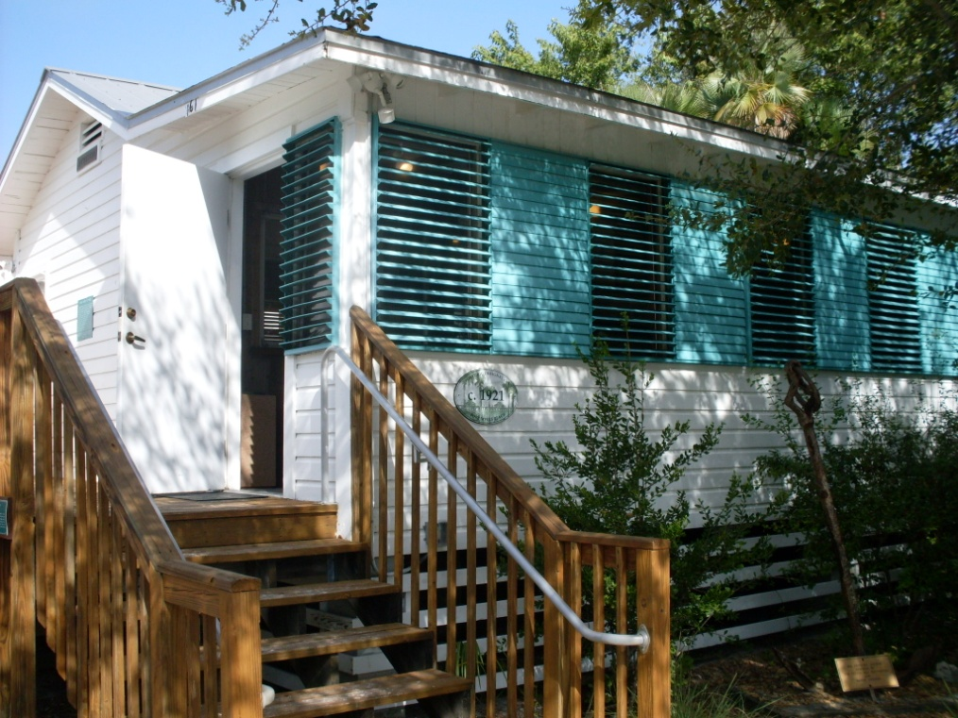
Historic Cottage and Matanzas Pass Preserve in Fort Myers Beach

Slide 10
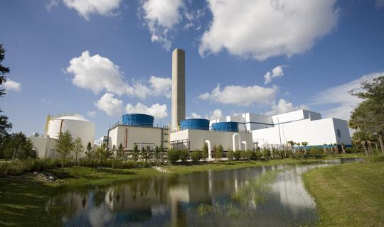
Lee County Waste-to-Energy Facility and Recycling Plant

Slide 11
FGCU
Flyer

Slide 15
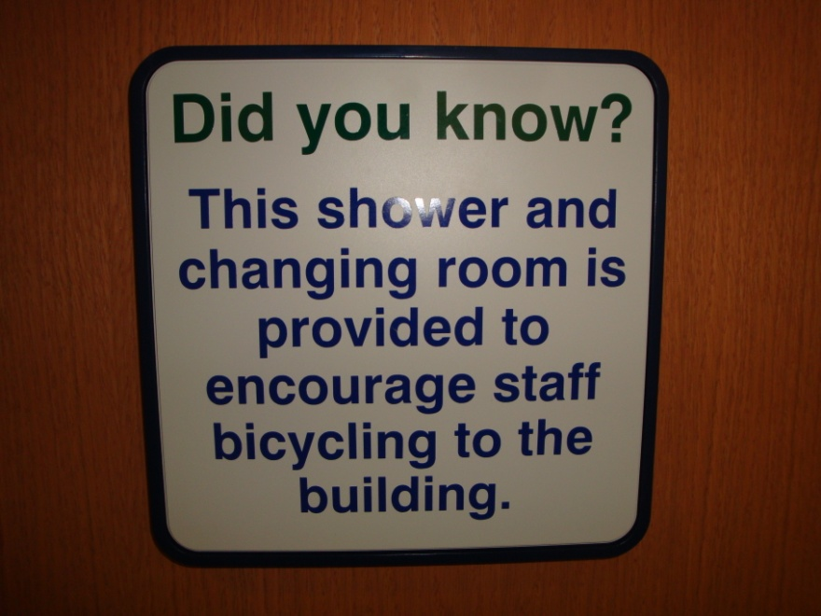
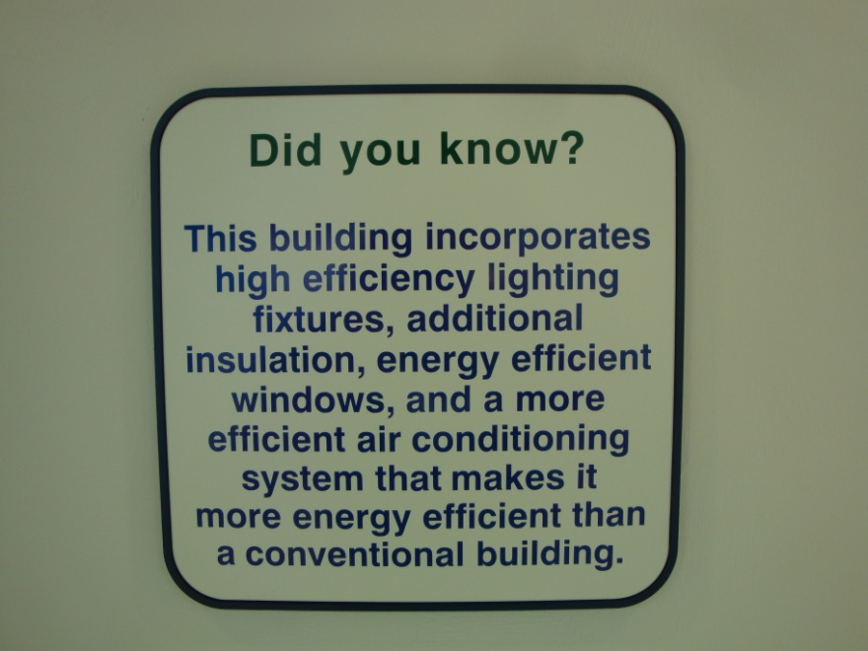
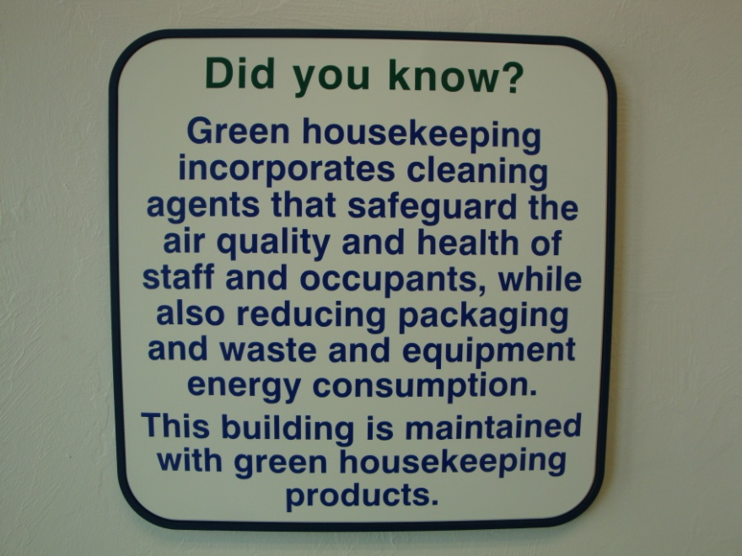
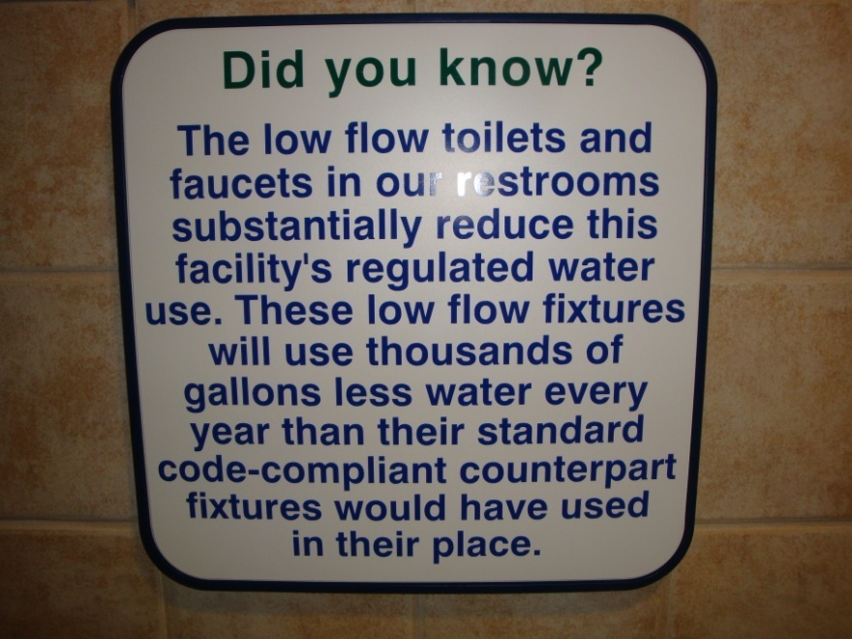

Slide 18
The End

